Slide 1
Moore Machine & Mealy Machine

Slide 2
Moore Machine
Moore machine is an FSM whose outputs depend on only the present state.
A Moore machine can be described by a 6 tuple (Q, ∑, O, δ, X, q0) where −
Q is a finite set of states.
∑ is a finite set of symbols called the input alphabet.
O is a finite set of symbols called the output alphabet.
δ is the input transition function where δ: Q × ∑ → Q
X is the output transition function where X: Q → O
q0 is the initial state from where any input is processed (q0 ∈ Q).

Slide 3
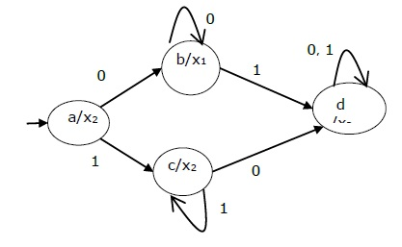
Moore Machine

Slide 4
Mealy Machine
A Mealy Machine is an FSM whose output depends on the present state as well as the present input.
It can be described by a 6 tuple (Q, ∑, O, δ, X, q0) where −
Q is a finite set of states.
∑ is a finite set of symbols called the input alphabet.
O is a finite set of symbols called the output alphabet.
δ is the input transition function where δ: Q × ∑ → Q
X is the output transition function where X: Q × ∑ → O
q0 is the initial state from where any input is processed (q0 ∈ Q).

Slide 5
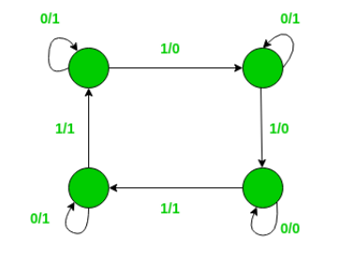
Mealy Machine

Slide 6
Mealy Machine vs. Moore Machine
The following table highlights the points that differentiate a Mealy Machine from a Moore Machine.
Mealy Machine | Moore Machine
Output depends both upon the present state and the present input | Output depends only upon the present state.
Generally, it has fewer states than Moore Machine. | Generally, it has more states than Mealy Machine.
The value of the output function is a function of the transitions and the changes, when the input logic on the present state is done. | The value of the output function is a function of the current state and the changes at the clock edges, whenever state changes occur.
Mealy machines react faster to inputs. They generally react in the same clock cycle. | In Moore machines, more logic is required to decode the outputs resulting in more circuit delays. They generally react one clock cycle later.

Slide 7
MOORE TO MEALY

Slide 8
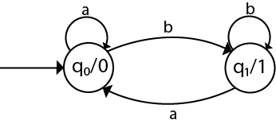

Slide 9
Q | a | b | Output(λ)
q0 | q0 | q1 | 0
q1 | q0 | q1 | 1
The equivalent Mealy machine can be obtained as follows:
λ' (q0, a) = λ(δ(q0, a))
= λ(q0)
= 0
λ' (q0, b) = λ(δ(q0, b))
= λ(q1)
= 1
The λ for state q1 is as follows:
λ' (q1, a) = λ(δ(q1, a))
= λ(q0)
= 0
λ' (q1, b) = λ(δ(q1, b))
= λ(q1)
= 1

Slide 10
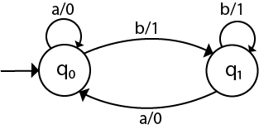

Slide 11
MEALY TO MOORE

Slide 12
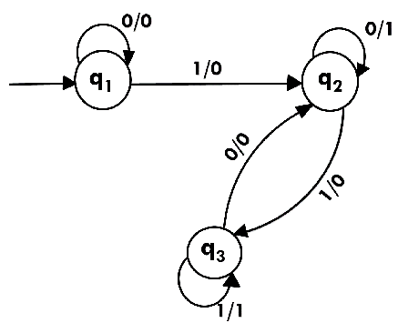

Slide 13
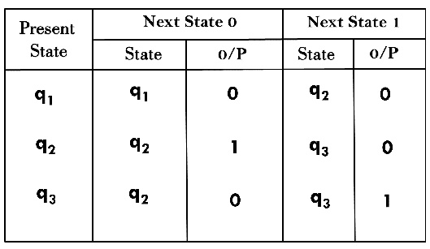

Slide 14
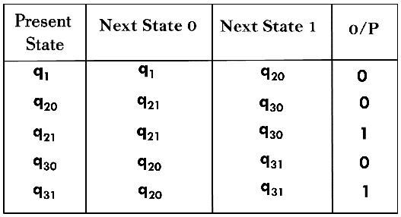

Slide 15
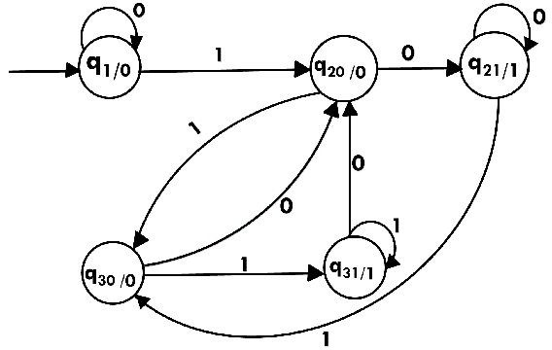

Slide 16
Transition graphs
Transition graph can be interpreted as a flowchart for an algorithm recognizing a language. A transition graph consists of three things:
A finite set of states, at least one of which is designated the start state and some of which are designated as final states.
An alphabet Σ of possible input symbols from which the input strings are formed.
A finite set of transitions that show the change of state from the given state on a given input.
A successful path through the transition graph is a series of edges forming a path beginning at the start state and ending at one of the final states.

Slide 17
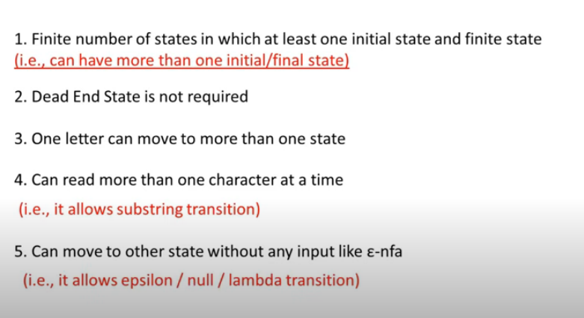

Slide 18
Kleene’s Theorem

Slide 19
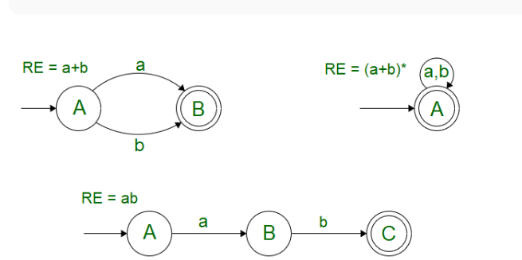
A language is said to be regular if it can be represented by using a Finite Automata or if a Regular Expression can be generated for it. This definition leads us to the general definition that; For every Regular Expression corresponding to the language, a Finite Automata can be generated. For certain expressions like :- (a+b), ab, (a+b)* ; It’s fairly easier to make the Finite Automata by just intuition as shown below. The problem arises when we are provided with a longer Regular Expression. This brings about the need for a systematic approach towards FA generation, which has been put forward by Kleene in Kleene’s Theorem
I Kleene’s Theorem-I :
For any Regular Expression r that represents Language L(r), there is a Finite Automata that accepts same language.

Slide 20
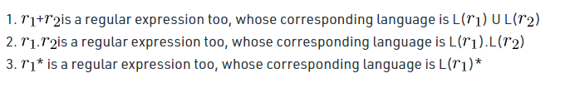
Let’s take in account the basic definition of Regular Expression where we observe that null, epsilon and a single input symbol “a” can be included in a Regular Language and the corresponding operations that can be performed by the combination of these are: Say, R1 and R2 be two regular expressions. Then

Slide 21
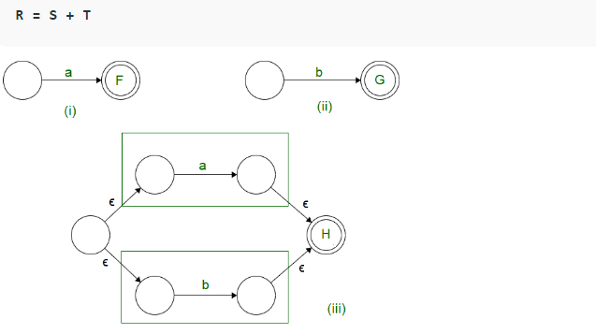
In case of union operation we can have a new start state, from which, null transition proceeds to the starting state of both the Finite State Machines.
The final states of both the Finite Automata’s are converted to intermediate states. The final state is unified into one which can be traversed by null transitions.

Slide 22
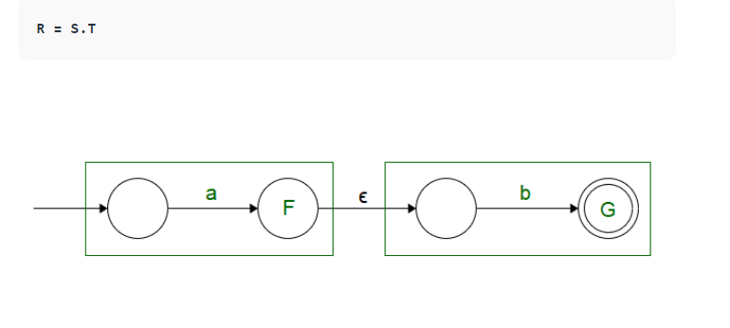
In case of concatenation operation we can have the same starting state as that of S, the only change occurs in the end state of S, which is converted to an intermediate state followed by a Null Transition.
The Null transition is followed by the starting state of T, the final state of T is used as the end state of R.

Slide 23
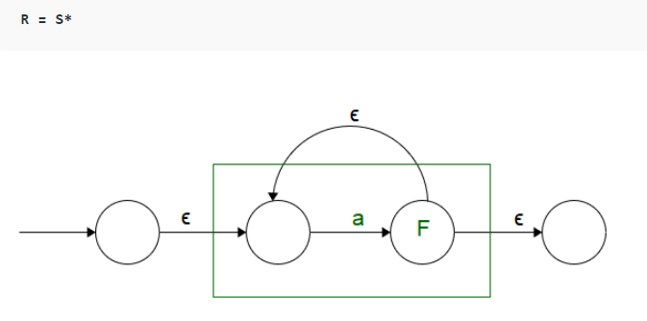
A new starting state is added, and S has been put as an intermediate state so that self looping condition could be incorporated.
Starting and Ending states have been defined separately so that the self looping condition is not disturbed.

Slide 24
Theorem – It gives a systematic approach towards the generation of a Finite Automata for the provided Regular Expression.

